Slide 1
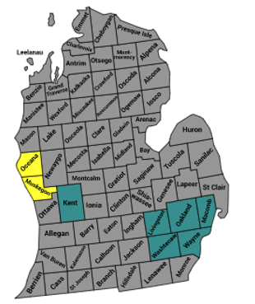
21 new Medicare counties for 2021 – 2 new Marketplace counties for 2021
Molina of Michigan Medicare and Marketplace
2021 Expansion
Emmet
Cheboygan
Presque Isle
Charlevoix
Montmorency
Alpena
Antrim
Otsego
Leelanau
Kalkaska
Crawford
Oscoda
Alcona
Benzie
Grand Traverse
Iosco
Missaukee
Roscommon
Ogemaw
Manistee
Wexford
Arenac
Lake
Osceola
Clare
Gladwin
Huron
Mason
Bay
Mecosta
Isabella
Midland
Tuscola
Sanilac
Oceana
Newaygo
Montcalm
Gratiot
Saginaw
Lapeer
Muskegon
Genesee
St. Clair
Kent
Ionia
Clinton
Shiawassee
Macomb
*
Ottawa
Livingston
Oakland
Barry
Eaton
Ingham
Wayne
Allegan
Jackson
Washtenaw
Van Buren
Kalamazoo
Calhoun
*
Monroe
St. Joseph
Branch
Hillsdale
Lenawee
Berrien
Cass
Current
Existing MMP Counties
Expansion
Current
Expansion
Notes:
Expansion counties TBD

